Slide 2
Learning Objectives (1 of 2)
Define artificial intelligence, and explain how AI technologies support decision making
Describe an expert system, its applications, and its components
Describe case-based reasoning
Summarize the types of intelligent agents and how they are used

Slide 3
Learning Objectives (2 of 2)
Describe fuzzy logic and its uses
Explain artificial neural networks
Describe how genetic algorithms are used
Explain natural-language processing and its advantages and disadvantages
Summarize the advantages of integrating AI technologies into decision support systems
Explain contextual computing

Slide 4
What is Artificial Intelligence?
Related technologies that try to simulate and reproduce human thought behavior
Artificial intelligence (AI) technologies
Apply computers to areas that require knowledge, perception, reasoning, understanding, and cognitive abilities
Concerned with generating and displaying knowledge and facts

Slide 5
AI Technologies Supporting Decision Making
Decision makers use information technologies in decision-making analyses
What-is: used in transaction-processing systems and management information systems
What-if: used in decision support systems and to answer questions such as why, what it means, what should be done, and when should it be done

Slide 6
13.1 Applications of AI (1 of 2)
Field | Organization | Applications
Energy | Arco and Tenneco Oil Company | Neural networks used to help pinpoint oil and gas deposits
Government | Internal Revenue Service | Software used to read tax returns and spot fraud
Human services | Merced County, California | Expert systems used to decide if applicants should receive welfare benefits
Marketing | Spiegel | Neural networks used to determine most likely buyers from a long list
Telecommunications | BT Group | Heuristic search used for a scheduling application that provides work schedules for more than 20,000 engineers
Transportation | American Airlines | Expert systems used to schedule the routine maintenance of airplanes

Slide 7
13.1 Applications of AI (2 of 2)
Field | Organization | Applications
Inventory/forecasting | Hyundai motors | Neural networks and expert systems used to reduce delivery time by 20 percent and increase inventory turnover from 3 to 3.4
Inventory/forecasting | SCI systems | Neural networks and expert systems used to reduce on-hand inventory by 15 percent, resulting in $180 million in annual savings
Inventory/forecasting | Reynolds Aluminum | Neural networks and expert systems used to reduce forecasting errors by 2 percent, resulting in an inventory reduction of 1 million pounds
Inventory/forecasting | Unilever | Neural networks and expert systems used to reduce forecasting errors from 40 percent to 25 percent, resulting in a multimillion-dollar savings

Slide 8
Robots (1 of 3)
Most successful application of AI
Excel at performing simple, repetitive tasks
Used to free workers from tedious or hazardous jobs
Have limited mobility and some have limited vision
Controlled by a computer program that includes commands

Slide 9
Robots (2 of 3)
Programming languages
Variable Assembly Language (VAL)
Functional Robotics (FROB)
A Manufacturing Language (AML)
Personal robots have limited mobility, vision, and speech capabilities
Currently used as prototypes to test certain services

Slide 10
Robots (3 of 3)
Soft robots: simpler to make and cost less
Applications
High-speed food handling
Precise pick and place
Adaptive grasping
Warehouse logistics
Advanced assembly
Medical field

Slide 11
Expert Systems (1 of 2)
Mimic human expertise in a field to solve a problem in a well-defined area
Must be applied to activities that human experts have already handled to be successful
Used in search engines to better understand users’ queries

Slide 12
Expert Systems (2 of 2)
Work with heuristic data
Heuristic data encourages applying knowledge based on experience to find a solution to a problem

Slide 13
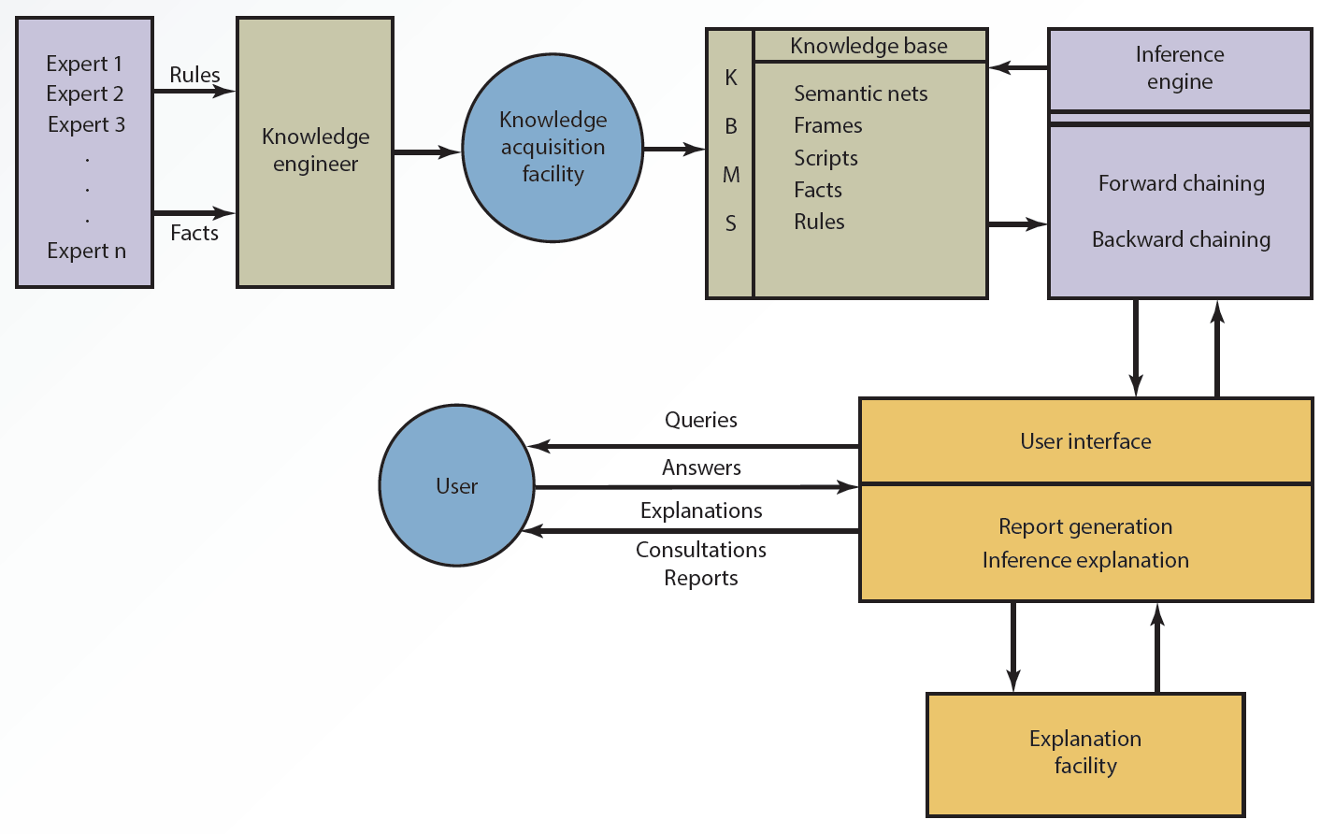
13.1 An Expert System Configuration

Slide 14
Components of an Expert System (1 of 5)
Knowledge acquisition facility
Software package with manual or automated methods for acquiring and incorporating new rules and facts
Enables growth of an expert system

Slide 15
Components of an Expert System (2 of 5)
Knowledge base
Similar to a database
Keeps track of rules and explanations associated with facts in addition to storing facts
Factual knowledge
Heuristic knowledge
Meta-knowledge

Slide 16
Components of an Expert System (3 of 5)
Knowledge base management system (KBMS)
Similar to a DBMS
Used to keep the knowledge base updated, with changes to facts, figures, and rules
User interface
Provides user-friendly access to the expert system

Slide 17
Components of an Expert System (4 of 5)
Explanation facility
Performs tasks similar to what a human expert does by explaining to end users how recommendations are derived
Inference engine
Similar to the model base component
Uses different techniques (e.g., forward and backward chaining) to manipulate a series of rules

Slide 18
Components of an Expert System (5 of 5)
Forward chaining
Series of “if-then-else” condition pairs is performed
“If” condition is evaluated first, then the corresponding “then-else” action is executed
Backward chaining
Expert system starts with the goal and backtracks to find the right solution

Slide 19
Uses of Expert Systems
Airline industry
Forensics lab work
Banking and finance
Education
Agriculture and food industry
Personnel management
Security and U.S. government

Slide 20
Criteria for Using Expert Systems
Extensive human expertise is needed
Can be represented as rules or heuristics
Decision or task has already been handled successfully by human experts
Requires consistency and standardization
Involves many rules and complex logic
Subject domain is limited
Experts in the organization are scarce

Slide 21
Criteria for Not Using Expert Systems
Presence of few rules or too many rules
Involvement of well-structured numerical problems and broad range of topics but not many rules
Disagreement among experts
Requirement for human expertise

Slide 22
Advantages of Expert Systems
Never become distracted, forgetful, or tired
Duplicate and preserve expertise of scarce experts
Preserve expertise of employees who are retiring or leaving
Create consistency in decision making
Improve decision-making skills of nonexperts

Slide 23
Case-Based Reasoning (1 of 2)
Case-based reasoning (CBR) is a problem-solving technique
Matches a new case with a previously solved case and its solution
Both stored in a database
Offers a solution after searching for a match
A human expert is required to solve the problem if CBR fails to find a match

Slide 24
Case-Based Reasoning (2 of 2)
Design and implementation involves four Rs
Retrieve
Reuse
Revise
Retain

Slide 25
Intelligent Agents (1 of 6)
Software capable of reasoning and following rule-based processes
Popular in e-commerce
Other names
Bots
Virtual agents (VAs)
Intelligent virtual agents (IVAs)

Slide 26
Intelligent Agents (2 of 6)
Characteristics of intelligent agents
Adaptability
Autonomy
Collaborative behavior
Humanlike interface
Mobility
Reactivity

Slide 27
Intelligent Agents (3 of 6)
Applications of intelligent agents
Web marketing
Collect information about customers and use it to better market products and services
Virtual catalogs
Smart or interactive catalogs
Display product descriptions based on customers’ previous experiences and preferences

Slide 28
Intelligent Agents (4 of 6)
Shopping and information agents
Help users navigate through vast resources available on the Web and provide better results in finding information
Serve as search engines, site reminders, or personal surfing assistants

Slide 29
Intelligent Agents (5 of 6)
Personal agents
Perform specific tasks for a user, such as remembering information for filling out Web forms

Slide 30
Intelligent Agents (6 of 6)
Data-mining agents
Work with a data warehouse
Detect trends and discover information and relationships among data items that were not readily apparent
Monitoring and surveillance agents
Track and report on computer equipment and network systems to predict when a system crash or failure might occur

Slide 31
Fuzzy Logic
Allows a smooth, gradual transition between human and computer vocabularies
Deals with variations in linguistic terms by using a degree of membership in a set
Designed to help computers simulate vagueness and uncertainty in common situations
Allows computers to reason similar to humans

Slide 32
Uses of Fuzzy Logic
Used in several areas
Search engines
Chip design
Database management systems
Software development
Appliances

Slide 33
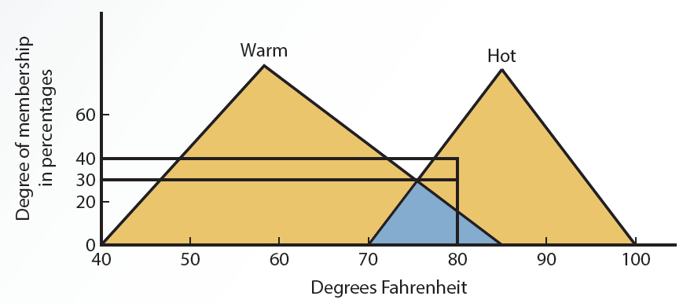
13.3 Degree of Membership in a Fuzzy System

Slide 34
Machine Learning (1 of 3)
Process and procedure by which knowledge is gained through experience
Several applications
Social media and identifying faces in photos
Recognizing commands spoken into smartphones
Designing intelligent robots
Artificial neural networks (ANNs)

Slide 35
Machine Learning (2 of 3)
Artificial neural networks (ANNs)
Learn and are capable of performing tasks that are difficult with conventional computers
Used for poorly structured problems
Cannot supply an explanation for the solution
Use patterns instead of the if-then-else rules used by expert systems
Create a model based on input and output

Slide 36
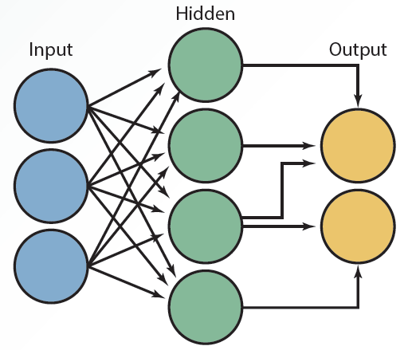
13.4 Artificial Neural Network Configuration

Slide 37
Machine Learning (3 of 3)
Tasks that involve the use of ANNs
Bankruptcy prediction
Credit rating
Investment analysis
Oil and gas exploration
Target marketing
Computer and network security

Slide 38
Genetic Algorithms
Search algorithms that mimic the process of natural evolution
Generate solutions to optimization
Find the combination of inputs that generates the most desirable outputs
Search problems using mutation, selection, crossover, and chromosome techniques

Slide 39
Natural-Language Processing (1 of 3)
Developed so that users can communicate with computers in human language
Provides a question-and-answer setting that is natural and easier for people to use
Useful with databases
Disadvantage
Complexity of the human language renders the development of NLP systems difficult

Slide 40
Natural-Language Processing (2 of 3)
Categories
Interface to databases
Machine translation
Text scanning and intelligent indexing programs
Generating text for automated production of standard documents
Speech systems for voice interaction with computers

Slide 41
Natural-Language Processing (3 of 3)
Activities performed
Interfacing
Accepting human language as input
Carrying out the corresponding command
Generating the necessary output
Knowledge acquisition
Using the computer to read large amounts of text, understand the information, and summarize important points

Slide 42
Integrating AI Technologies into Decision Support Systems (1 of 2)
AI-related technologies can improve the quality of decision support systems (DSSs)
Result in integrated or intelligent DSSs (IDSSs)
Add explanation capabilities by integrating expert systems
Add learning capabilities by integrating ANNs
Create a user-friendly interface by integrating an NLP system

Slide 43
Integrating AI Technologies into Decision Support Systems (2 of 2)
Benefits of integrating expert systems into the database component of a DSS
Adding deductive reasoning to traditional DBMS functions
Improving access speed and database creation and maintenance
Adding capability to handle uncertainty and fuzzy data
Simplifying query operations

Slide 44
Contextual Computing: Making Mobile Devices Smarter
Computing environment that is always present
Capable of feeling surroundings and offering recommendations based on who we are, where we are, and whom we are with
Based on the principle that computers can both sense and react to their environments

Slide 45
Summary
Artificial intelligence technologies
Apply computers to areas that require knowledge, perception, reasoning, understanding, and cognitive abilities
Robotics, expert systems, fuzzy logic systems, intelligent agents, artificial neural networks, natural-language processing, etc.
Context-aware applications
Include smartphones and Facebook

